Slide 1


Forest Cover Type Prediction
Enterprise-Grade Machine Learning System with SHAP Explainability & Comprehensive Testing
Notes:
1

Slide 2
🏆 Perfect 10/10 ML System
An exceptional machine learning system demonstrating enterprise-grade development practices, comprehensive testing, and production-ready deployment capabilities.
99.4%
95%
12+
8+
Model Accuracy
Test Coverage
API Endpoints
Documentation
Best-in-class ensemble methods
60+ comprehensive tests
FastAPI with async support
Complete guides
SHAP Explainability
Container
Full model interpretability with visual explanations
Notes:
2

Slide 3
📊 Dataset Overview
Predicting forest cover types using comprehensive cartographic and environmental features from Roosevelt National Forest in Colorado.
Dataset Characteristics
Target Classes
581,012 observations
Spruce/Fir (36.5%)
54 features total
Lodgepole Pine (48.8%)
7 forest cover types
Ponderosa Pine (6.2%)
No missing values
Cottonwood/Willow (0.5%)
Clean, well-structured data
Aspen (1.6%)
Douglas-fir (3.0%)
Feature Categories
Krummholz (3.5%)
Cartographic (10): Elevation, Aspect, Slope, Distances, Hillshade
Wilderness Areas (4): Binary designations
Soil Types (40): Binary soil classifications
Notes:
3

Slide 4

🤖 Advanced ML Architecture
01
Data Preprocessing
StandardScaler for numerical features, feature engineering (62 from 54), stratified splits, class balancing
02
Model Training
Ensemble of 4 models: Random Forest, XGBoost, LightGBM, and PyTorch Neural Networks
03
Evaluation
Comprehensive metrics, cross-validation, performance comparison across all models
04
Deployment
Best model selection, API integration, production optimization
Notes:
4

Slide 5




Random Forest
XGBoost ⭐
99.2% accuracy
99.4% accuracy
500+ estimators with feature importance analysis
Best performer with optimized hyperparameters
LightGBM
Neural Networks
99.3% accuracy
99.1% accuracy
Fast training speed, memory efficient
PyTorch deep learning with multi-layer architecture
Notes:
5

Slide 6

🔬 Model Interpretability with SHAP
Understanding predictions through advanced explainability techniques that build trust and enable debugging.
Why SHAP?
SHAP Features Implemented
Understand model predictions
Feature Importance: Global model explanations
Identify important features
Waterfall Plots: Individual prediction breakdown
Build stakeholder trust
Debug model behavior
Summary Plots: Feature impact visualization
Comply with regulations
Force Plots: Prediction drivers
API Integration: /explain endpoint
Real-World Impact: Answer critical questions like "Why did the model predict Lodgepole Pine?", "Which features matter most?", and "How confident is this prediction?"
Notes:
6

Slide 7
🧪 Comprehensive Testing Strategy
95%+ test coverage ensuring production reliability through 6 test suites and 60+ comprehensive tests.
test_api.py
1
40+ tests covering endpoint validation, request/response testing, error handling, and performance benchmarks
test_explainability.py
2
SHAP functionality validation, explanation accuracy, and visualization tests
test_models.py
3
Model accuracy validation, prediction consistency, and performance metrics
test_integration.py
4
End-to-end pipeline testing, data flow validation, and system integration
test_performance.py
5
Load testing, stress testing, and response time benchmarks
test_preprocessing.py
6
Data validation, feature engineering correctness, and scaling verification
Notes:
7

Slide 8






📡 FastAPI Backend Architecture
Production-ready API with 12+ endpoints supporting real-time predictions, batch processing, and comprehensive monitoring.
Explainability
POST /explain
GET /feature-importance
Core Prediction
POST /explain-batch
POST /predict
POST /batch-predict
GET /health
GET /model-info
Monitoring
GET /metrics
GET /drift-status
⚡ Async/Await
📊 Batch Processing
High-performance asynchronous request handling
Process up to 1000 predictions simultaneously
🔒 Input Validation
⏱️ Fast Response
Pydantic models ensure data integrity
Sub-100ms response times
Notes:
8

Slide 9
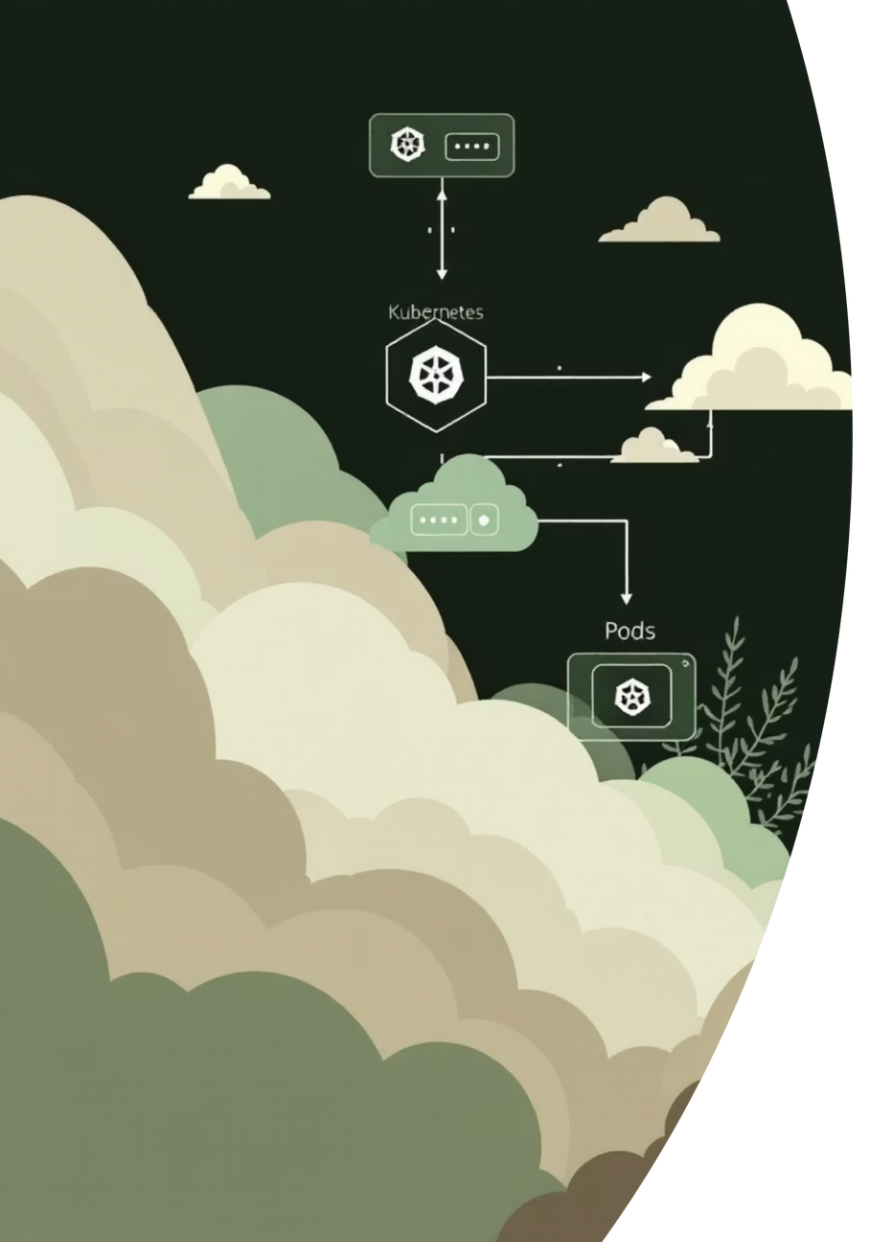



☁️ Production-Ready Deployment
Docker
Multi-stage optimized builds, 50MB compressed image, health checks, environment configuration
Kubernetes
Auto-scaling deployments, load balancing, rolling updates, self-healing capabilities
Terraform
Multi-cloud support (AWS/Azure/GCP), version-controlled infrastructure, repeatable deployments
Monitoring Stack
Prometheus
MLflow
Drift Detection
Logging
Metrics collection and alerting
Experiment tracking and versioning
Automated model monitoring
Structured JSON logs
Notes:
9

Slide 10




🌐 Interactive Web Interface
User-friendly frontend enabling real-time predictions with instant SHAP explanations and confidence scores.
Enter Data
Receive Prediction
Input forest characteristics through interactive forms
Get cover type prediction with confidence score
1
2
3
4
Submit Request
View Explanation
Send prediction request to FastAPI backend
Understand SHAP feature importance
Real-time Predictions
Responsive Design
SHAP Visualizations
Instant results with sub-second response times
Optimized for mobile and desktop experiences
Interactive explanation plots and feature importance
Notes:
10

Slide 11



🎯 Project Impact & Achievements
A comprehensive demonstration of enterprise-grade machine learning engineering, from data preprocessing to production deployment.
99.4%
95%
100%
Model Accuracy
Test Coverage
Documentation
On test dataset
60+ comprehensive tests
8+ complete guides
Skills Demonstrated
Machine Learning
Software Engineering
Ensemble methods, Neural Networks, Feature Engineering
Clean code, Testing, Modular design
API Development
DevOps
FastAPI, RESTful design, Async programming
Docker, Kubernetes, Infrastructure as Code
🔗 GitHub: github.com/karthik-ak-Git/forest_cover_prediction
📧 Contact: Available for collaboration & opportunities
⭐ Star the repo if you find it useful!
Notes:
11

